Slide 1
Graphic APIs
Games Academy July 2015
Benjamin Nitschke - Delta Engine

Slide 2
About me: BenjaminNitschke.com
2002-2004: First commercial .NET Game: Arena Wars
2005: Rocket Commander Tutorial, 1 Million Views
2006: Wrote Professional XNA Game Programming Book
2008: meinSport.de Online Sport Community Site
2009: FireBurst Xbox, PlayStation, PC with Unreal Engine
2010: Released Games on iOS, Android, WinPhone, W8 ..
2012: SoulCraft Mobile RPG (10+ Million Downloads)
since 2012: CEO Delta Engine, .NET, C++, JS Conversion
Notes:
2006: Created XNA Racing Game, one of the first full hd games on Xbox 360 and very popular XNA showcase game, got around 1 million youtube views
Current interests are compilers, functional languages and engines in general. I am also creating a new low level computer language that can write itself for future work. Most recently learned and used Clojure, Lisp and F#, worked on a few smaller games with our engine and some bigger contract work (native iOS, Android development), also helped SoulCraft development and just released it on Steam this week.

Slide 3
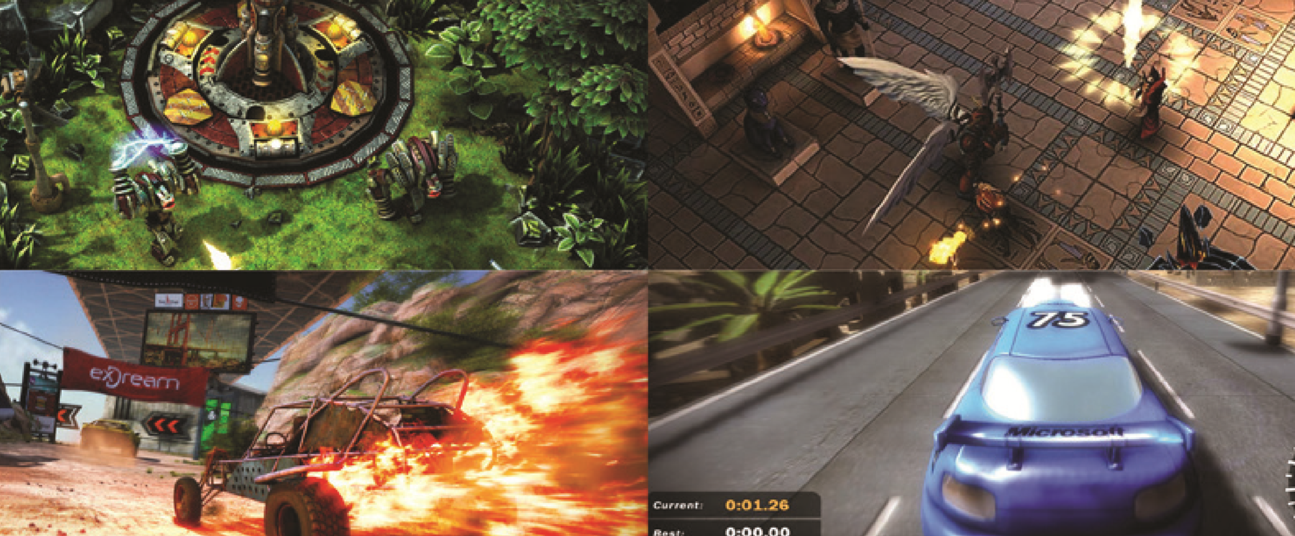
About me: Games created
Notes:
Arena Wars (2002-2004), SoulCraft (2012), Fireburst (2009) and XNA Racing Game (2006)

Slide 4
Overview
OpenGL
Windows, Unix, Mac OS: OpenGL
Android, iOS, WebGL, most phones: OpenGL ES
Direct3D
Windows, Xbox, Windows Phone
DirectX 1-8
Direct3D 9
Direct3D 10
Direct3D 11

Slide 5
There is more
X3D (xml based)
Mantle (developed by AMD)
Vulkan (Khronos, next gen, glNext, Mantel)
RenderMan (Pixar)
RenderWare (consoles)
Glide API (3dfx, Unreal, NFS, Quake, ...)
QuickDraw 3D (developed by Apple)
Stage3D (3D library in Flash version 11)
Notes:
https://en.wikipedia.org/wiki/List_of_3D_graphics_libraries
https://en.wikipedia.org/wiki/RenderWare

Slide 6
And many 3D APIs on top of it
3D APIs
ClanLib, Crystal Space, Horde3D, HOOPS 3D Graphics System, Irrlicht Engine, Java 3D, JMonkey Engine, Mobile 3D Graphics API, JT Open, OGRE, OpenGL Performer, OpenSceneGraph, OpenSG, QSDK, Vega Prime
Web
Blend4Web, CopperLicht, O3D, Three.js, X3DOM, StormEngineC, Papervision3D (Flash)

Slide 7
What is most popular for games?
Unity3D
Unreal Engine
CryEngine
Source
Other: RPG, Blender, GameMaker, Construct, XNA, Quake, Doom, DE, etc.
Roll your own
Notes:
https://en.wikipedia.org/wiki/List_of_game_engines
Unity3D is really popular for smaller studios and indies, but Unreal Engine is also highly successful, especially for big studios and very complex fps and rpg games.
Most engines are written in C++ and allow scripting in it plus a scripting language like C#, Lua, JS, BluePrint, etc.
Pretty much all engines have become cross platform and support mobile even if they started on just one or a few similar platforms (e.g. Unity on Mac, Unreal on PC and then Consoles).

Slide 8
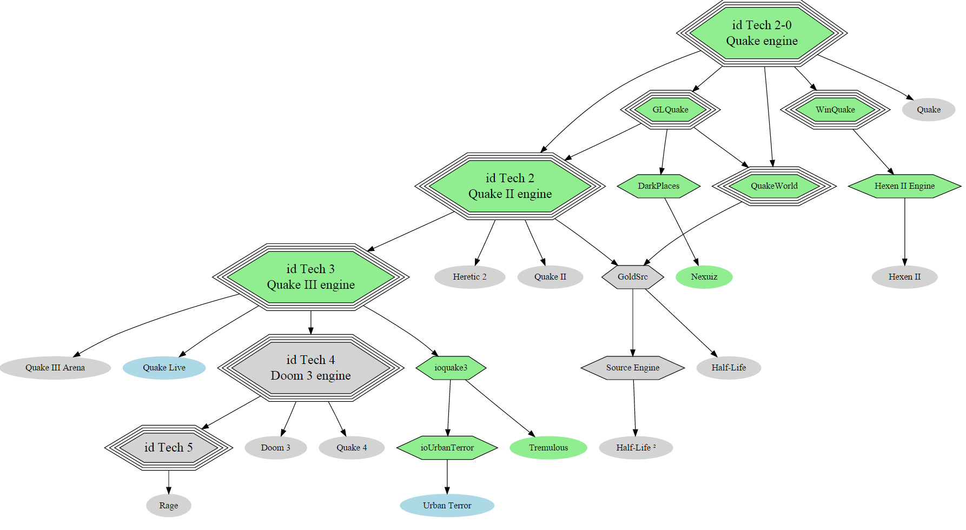
Game Engine Evolution Example
Notes:
http://www.appia.com/blog/key-programming-languages-for-mobile-developers
http://mashable.com/2014/01/21/learn-programming-languages/

Slide 9
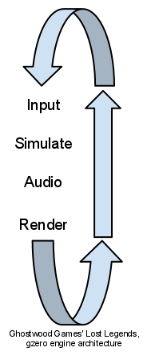
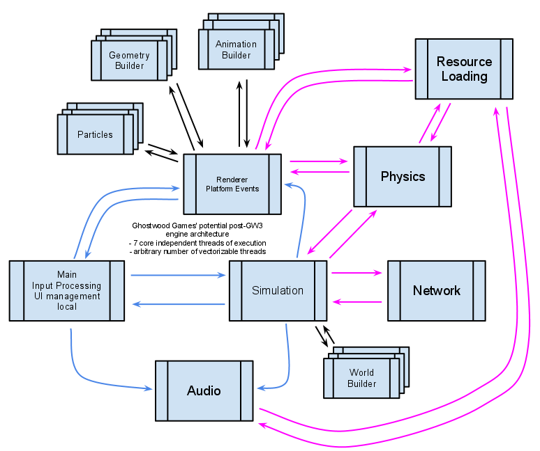
Game Engine Architecture
Notes:
http://www.appia.com/blog/key-programming-languages-for-mobile-developers
http://mashable.com/2014/01/21/learn-programming-languages/

Slide 10
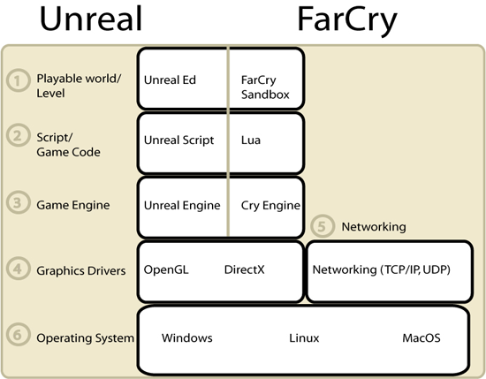
Game Engine Parts
Focus for today!

Slide 11
Live Coding
Deep dive:
Creating a framework with
OpenGL and
DirectX backends
Visual Studio 2013 or 2015
C# .NET 4.0
OpenGL via OpenTK
DirectX via SharpDX
Notes:
Since we will be coding together now slides do not make so much sense, most things need to be explained and everyone should be typing his game. Links to the existing TextAdventure code will be given in the next slide, which we will only look at by the end of today.

Slide 12
Questions?
All code and these slides are available at:
https://github.com/BenjaminNitschke/GraphicAPIsCourse

Slide 13
Books
Graphic Gems I-V
Game Programming Gems 1-8
Shader X
Game Programming Patterns
http://gameprogrammingpatterns.com/contents.html
Game Coding Complete
Game Engine architecture
AI Game Programming Wisdom 1-3
Notes:
http://www.realtimerendering.com/resources/GraphicsGems/
http://www.amazon.com/gp/bestsellers/books/15375251/ref=pd_zg_hrsr_b_1_4_last

Slide 14
Links
https://www.opengl.org/
http://www.opentk.com/
DirectX Walkthroughs
https://directxtk.codeplex.com
http://sharpdx.org/
http://www.monogame.net/
Notes:
http://www.realtimerendering.com/resources/GraphicsGems/
http://www.amazon.com/gp/bestsellers/books/15375251/ref=pd_zg_hrsr_b_1_4_last

